Slide 1

Department of Computer Science and Engineering
SKIN LESION CLASSIFICATION
Date: 13 May 2021
K.HARSHINI : 17WH1A0522
V.PRAVALIKA : 17WH1A0543
K.CHAITRA : 17WH1A0509
Internal Guide: Mr. Madan Reddy
Designation: Assistant Professor

Slide 2


Abstract
Why Should I Study this course?
Examples
BVRIT HYDERABAD College of Engineering for Women
Problem Statement:
Melanoma is deadly Skin Cancer. There is a high similarity between different kinds of skin lesion, which leads to incorrect classification. Accurate classification of a skin lesion in its early stages saves human life.
Project Objective:
This project aims at classifying skin lesion images in to 7 classes namely Melanoma, Melanocytic nevus, Basal cell carcinoma, actinic keratosis, Benign keratosis, Dermatofibroma and Vascular lesion using neural networks.

Slide 3
Dataset
Dataset Description:
It has 3 files, 2 files containing 5000 images and 1 csv file containing metadata
HAM10000 is a dataset of 10015 training images for detecting pigmented skin lesions. This dataset has been formed by collecting dermatoscopic images from different populations, acquired and stored by different modalities.
Why Should I Study this course?
Examples
BVRIT HYDERABAD College of Engineering for Women
Contents of HAM10000_metadata.csv
Attribute | Description
lesion_id | Unique number representing a lesion type
image_id | Unique number identifying the image
dx | Abbreviation for the lesion type (nv -> Melanocytic nevus, bkl -> Benign keratosis)
dx_type | Shows which test concluded the lesion (dermastopic analysis, biopsy, histopathical examination, others)
age | Person’s age
sex | Male/Female
localization | Indicates the position of lesion in human body (ear, back, hand, etc)

Slide 4
Architecture
Why Should I Study this course?
Examples
BVRIT HYDERABAD College of Engineering for Women
Data acquisition
Data-processing and cleaning
EDA
CNN-model building
Fitting model
Model evaluation

Slide 5
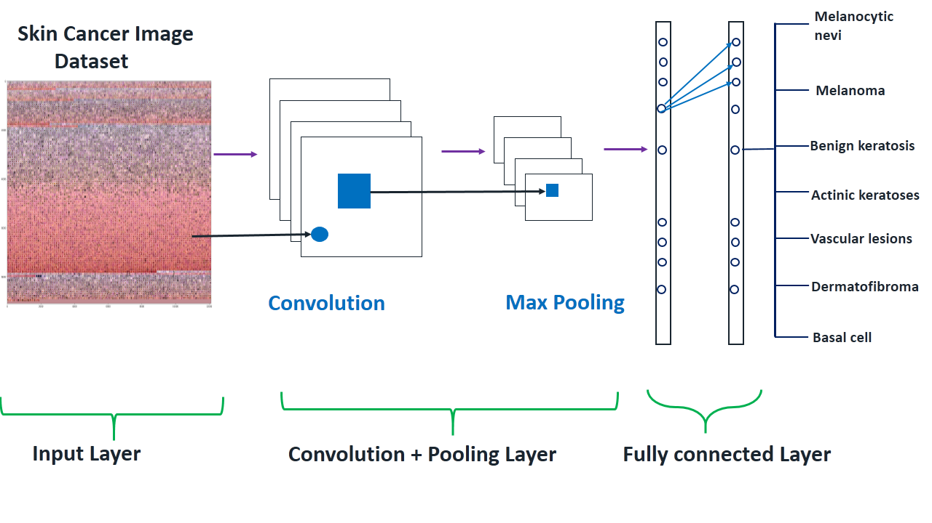
CNN-Model Architecture

Slide 6

Technology Stack
Technology Stack
Why Should I Study this course?
Examples
BVRIT HYDERABAD College of Engineering for Women
Supervised Machine Learning
Language : Python
IDE : Google Colab
Libraries : pandas, matplotlib, sklearn, keras (tensorflow)
Supervised Machine Learning
Language : Python
IDE : Google Colab
Libraries : pandas, matplotlib, sklearn, keras (tensorflow)

Slide 7
System Requirements
Why Should I Study this course?
Examples
BVRIT HYDERABAD College of Engineering for Women
Environment | Speciﬁcations
Hardware | Processor - Intel Core i3 Memory(RAM) - 4 GB Storage - 500GB
Software | Windows 7/Ubuntu

Slide 8
Timeline
Why Should I Study this course?
Examples
BVRIT HYDERABAD College of Engineering for Women
Review 0 | • Software Requirements • Base papers and references
Review1 | • Data Cleaning and Processing • Exploratory Data Analysis
Review 2 | • CNN Model building • Fitting model
Review 3 | Visualization and interpretation of results Report of the project

Slide 9
References
Why Should I Study this course?
Examples
BVRIT HYDERABAD College of Engineering for Women
[1] Saket S. Chaturvedi, Kajol Gupta, Prakash. S. Prasad, “Skin Lesion Analyser: An Efficient Seven-Way Multi-Class Skin Cancer Classification Using MobileNet”,May. 2020.
https://arxiv.org/abs/1907.03220
[2]Data set
https://www.kaggle.com/kmader/skin-cancer-mnist-ham10000
[3]M. A. A. Milton, “Automated Skin Lesion Classification Using Ensemble of Deep Neural Networks in ISIC 2018: Skin Lesion Analysis Towards Melanoma Detection Challenge,” Jan. 2019.
[4] Kawahara J, Hamarneh G. Multi-resolution-Tract CNN with Hybrid Pretrained and Skin Lesion Trained Layers. In: Wang L, Adeli E, Wang Q, Shi Y, Suk HI (eds) Machine Learning in Medical Imaging. MLMI 2016. Lecture Notes in Computer Science. 2016;10019. https://doi.org/10.1007/978-3-319-47157-0_20

Slide 10
Thank you

